Slide 1
Outlook for Holiday 2024
July 2024
Notes:
[Medium green title slide with white tagline
Alternate color options are available in the Layout Menu
Refer to color guidance for approved color combinations]

Slide 2
Study background
Survey of 99 digital retailers and their attitudes and expectations for the 2024 holiday retail season
Survey fielded late June 2024
Type of Merchant
Annual eCommerce Revenue
Source: CommerceNext Holiday Sentiment Survey July 2024

Slide 3
Merchants are optimistic
Considering both your company’s situation and the macro environment, how do you expect online holiday sales in 2024 will do compared to 2023?
43%
25%
Source: CommerceNext Holiday Sentiment Survey July 2024

Slide 4




But of course not everyone is optimistic; performance varies among companies
Recent year-over-year ecommerce/digital sales growth
Source: Company SEC filings

Slide 5
Unemployment levels around the world are single digits
% unemployed as a % of the labor force
North America
US | 4%
Canada | 6.3%
Mexico | 2.8%
Latin America
Brazil | 8%
Chile | 8.7%
Argentina | 8%
Europe
Germany | 3.3%
France | 7.4%
UK | 4.2%
Asia-Pacific
China | 5%
Japan | 2.5%
India | 4.7%
Source: IMF (April 2024)
Notes:
St louis fed

Slide 6
GDP growth around the world is positive
GDP growth around the world is positive
Real GDP, estimated % for 2024
North America
US | 2.7%
Canada | 1.2%
Mexico | 2.4%
Emerging Markets
Brazil | 2.2%
Russia | 3.2%
Nigeria | 3.3%
Europe
Germany | 0.2%
France | 0.7%
UK | 0.5%
Asia-Pacific
China | 4.6%
Japan | 0.9%
India | 6.8%
Source: IMF (April 2024)

Slide 7
Here is how the YOY growth number is looking
YTD growth (through May 2024)
Pureplay eCommerce
Restaurants
Apparel, accessories and footwear
Auto dealers
Health and personal care stores
Grocery
Electronics stores
Gas stations
Department stores
Home improvement
Furniture stores
Source: US Census Monthly Retail Sales (store types include eCommerce sales for those retailers); estimated delta from May 2024 sales

Slide 8
Promotional volume will be higher on key dates
Which best describes the volume/level of your holiday promotions this year versus last year for…
Thanksgiving and Black Friday
Cyber Monday and Cyber Week
December
Source: CommerceNext Holiday Sentiment Survey July 2024

Slide 9
Most retailers are trying some type of shipping promotion
Do you plan to adjust your shipping and handling offers this year in any of the following ways? (select all that apply)
Source: CommerceNext Holiday Sentiment Survey July 2024

Slide 10
But margins are expected to be mostly the same
How do you expect your margins to change in 2024 compared to 2023 (due to inflation, consumer confidence, promotional activity, etc.)?
28%
30%
Source: CommerceNext Holiday Sentiment Survey July 2024

Slide 11
The biggest concern is consumer sentiment
Which of the following concerns you for the 2024 holiday season? (select all that apply)
Source: CommerceNext Holiday Sentiment Survey July 2024

Slide 12
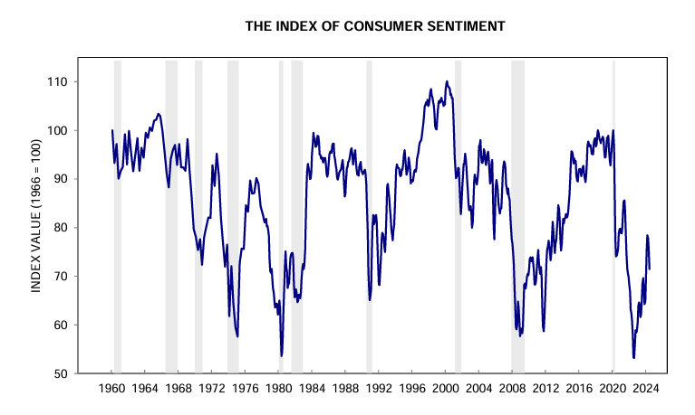
Consumer sentiment is still down
Source: University of Michigan Survey of Consumers

Slide 13
“This is a short selling season”

Slide 14
Pop quiz: Why is Thanksgiving never on November 29 or 30?

Slide 15
A short season affects shipping cutoffs
What is the last date prior to Christmas that consumers will be able to order from your site without having to pay expedited shipping fees this year? (select the most appropriate response)
Source: CommerceNext Holiday Sentiment Survey July 2024

Slide 16
Most retailers are not rushing packages to consumers
What is the standard (non-expedited) shipping commitment that you plan to offer to consumers this Holiday season? (select most appropriate response)
Source: CommerceNext Holiday Sentiment Survey July 2024

Slide 17
Btw, the challenges now vary a lot from the last time we surveyed merchants
2024
2021
Source: CommerceNext Holiday Sentiment Survey July 2024

Slide 18
There isn’t too much changing with respect to returns
10% of retailers said they will make their return policies stricter
80% of retailers said they are making no changes to their return policies
10% of retailers said they will make their return policies more lenient
Source: CommerceNext Holiday Sentiment Survey July 2024

Slide 19
Some final thoughts on what happens next
“Brick and mortar comes out ahead with regular folks not realizing how few days between TG and Xmas”
“Customers will be very price conscious and will be shopping earlier and later to find the deals”
“Same Day and BOPIS delivery methods will be used more”
“Big lift in sales after election”
“Post-election relief turns into renewed consumer confidence”
Source: CommerceNext Holiday Sentiment Survey July 2024

Slide 20
A few other things retailers are doing
Are you implementing any specific programs or campaigns to both attract new customers and enhance retention post-holiday season? (select all that apply)
Source: CommerceNext Holiday Sentiment Survey July 2024

Slide 21
Don’t be panicked about the 2024 US presidential election

Slide 22
We have seen this movie before, and even then retail persevered
Compared to last year, how do you expect your holiday shopping spend in November and December 2016 to change as a result of the 2016 presidential election?
Base: 1,012 online consumers
Source: Google Surveys (November 12-14, 2016)
Notes:
Data from survey

Slide 23
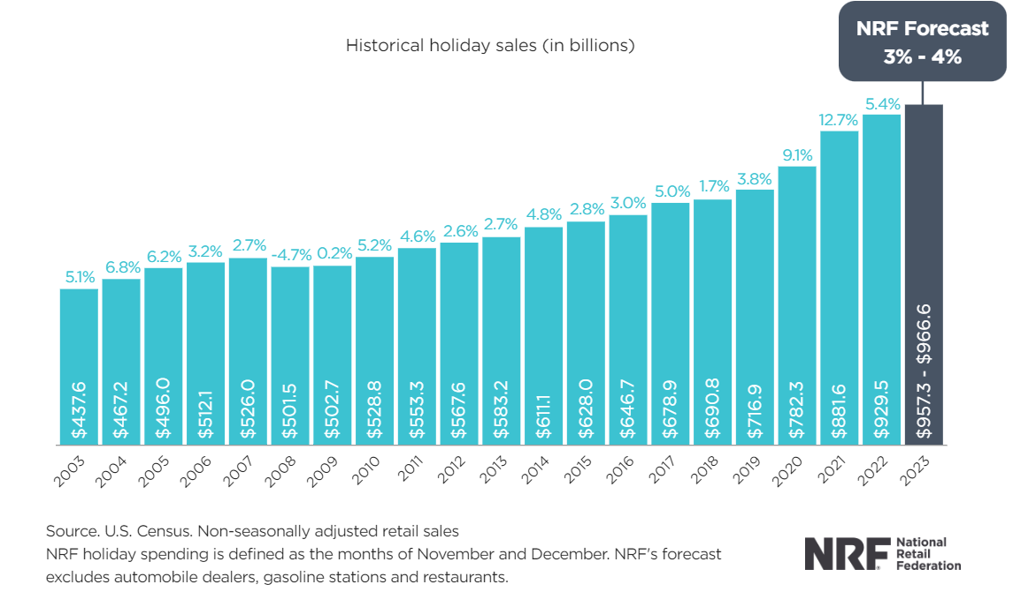
This was holiday spend in 2016

